Slide 1
Grade 7 Family Life

Slide 2
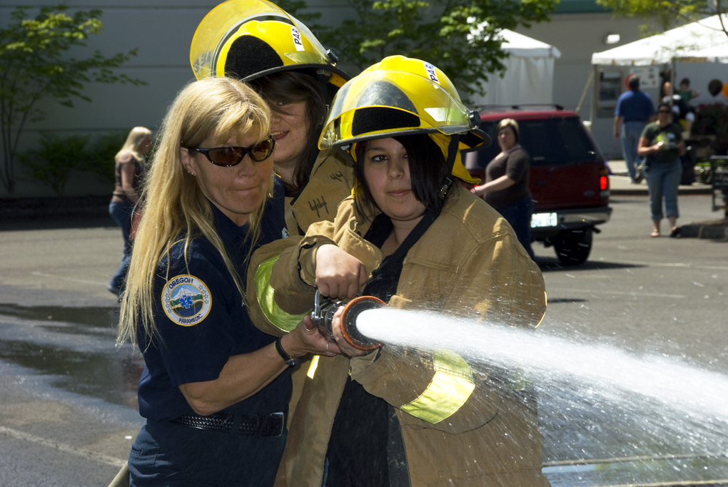
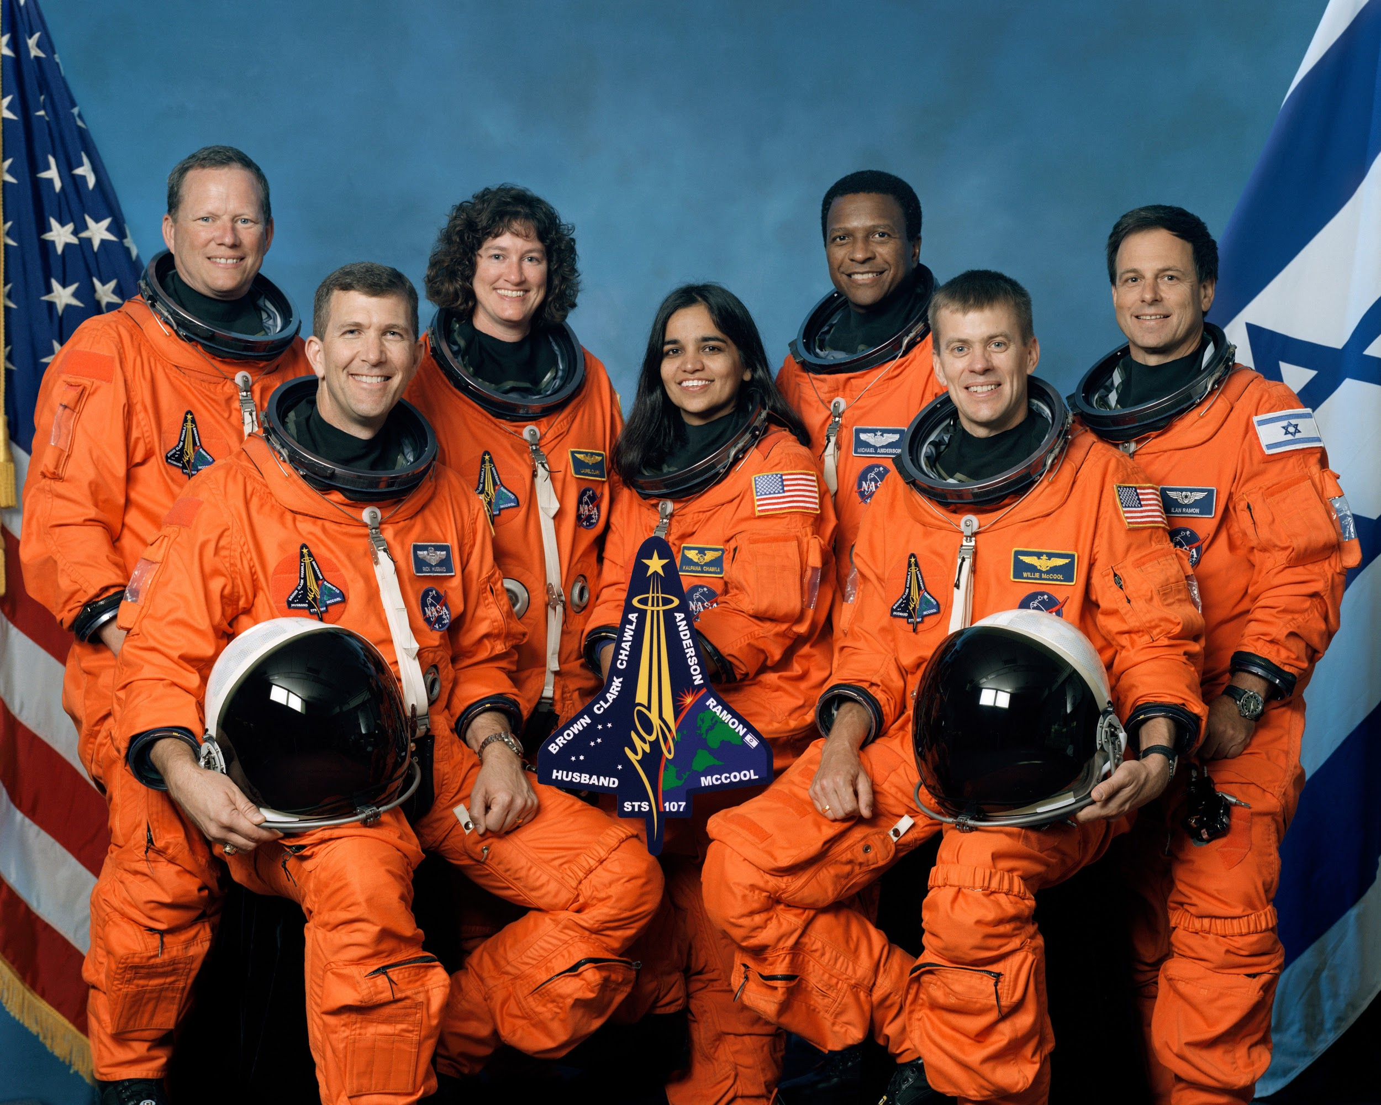
Gender
-Human beings are made in the image of God. -Males and females possess equal personal dignity. -God created humans both equally in his image. -Gender stereotypes what are they?

Slide 3
The Meaning of Love
-There are three different forms of love. Friendship Marriage Charity -Friendship is shared love between anyone: a sibling, a neighbor or a friend. -Marriage is shared love between a husband and wife. -Charity is shared love with God. -Some think that the only kind of love is sexual love and the only kind of friendship is a sexual one. Learning to be a good friend is the first step toward understanding the true meaning and beauty of sex.

Slide 4
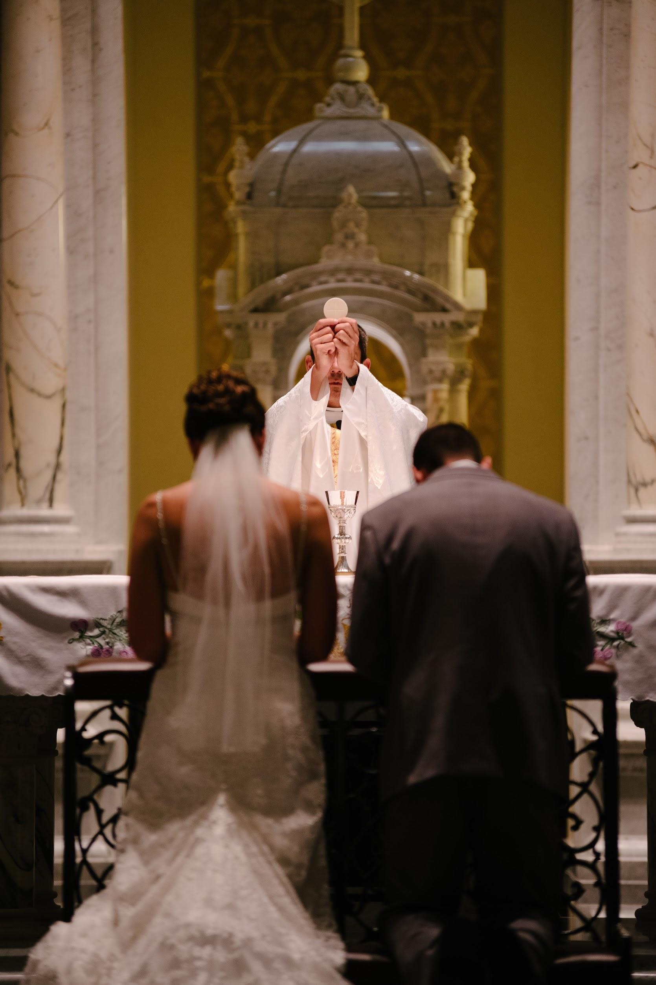
Chastity
-As we mature and grow older we may meet someone of the opposite sex and we are attracted by the way the person looks or acts. -We must all be mindful of the virtue of chastity. -Living a chaste life is about directing our sexuality toward authentic love it. Chastity is part of every kind of relationship. It is the virtue that allows us to do what is right, good and truly loving in every relationship. -One way we live the virtue of chastity is through the practice of abstinence. This is choosing to say no to all forms of sexual activity. -God’s plan for marriage requires both spouses to commit to a lifelong relationship based on fidelity, exclusivity, and openness to life.

Slide 5
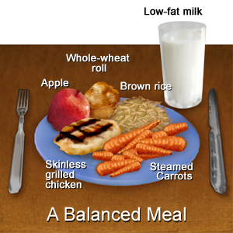
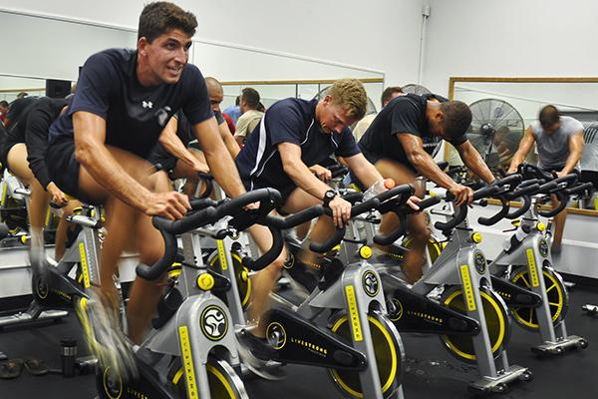
Taking Care of ourselves and drug and substance abuse.
-As we grow and get older we must maintain good hygiene. One must care for oneself both physically and mentally. -We must be sure to bathe everyday, wear clean clothes, brush teeth, use deodorant, exercise, get enough sleep, eat a balanced meal, balance time between studying, recreation, and relaxation, and make smart and good decisions. -Don’t abuse drugs and other unhealthy substances. -While many drugs may help our bodies get well and heal there is a dark side to drugs.

Slide 6
Choosing Not To
-Remember that drugs produce only a short-term “good” effect when used appropriately. When their use is abused, they create the long-term effect of dependency, an addiction. -Drug use had a different effect on different people. -An excessive use of anything is unhealthy and dangerous. (Movie Super Size Me 2004)

Slide 7
Tobacco and Alcohol
-These are 2 legal substances that people abuse. -Tobacco contains nicotine that is highly addictive. Many other tobacco products are poisonous and may eventually lead to cancer or lung disease. Vaping is not a safe alternate many people are dying from vaping. -Alcohol is found in beer, wine, and liquor. Alcohol begins to affect the body immediately. Alcohol flows to all parts of the body through the bloodstream. It impairs a person, making it difficult to function and make decisions. It changes a person’s perception, impairing a person’s ability to drive, speak, and walk. A person’s liver can become damaged. This is called cirrhosis. Many people have lost their lives due to abusing alcohol. -There are many other illegal substances that are much worse when abused. (Opiate crisis)

