Slide 1
8th Grade Family Life

Slide 2
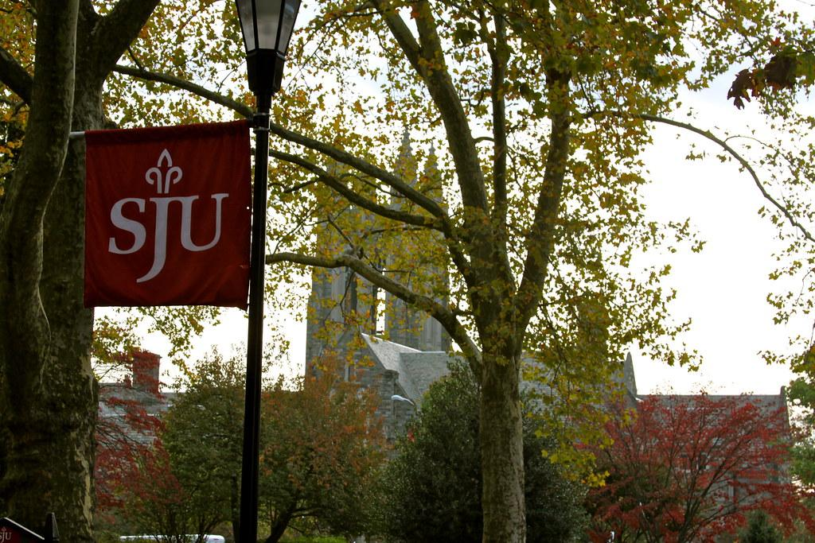
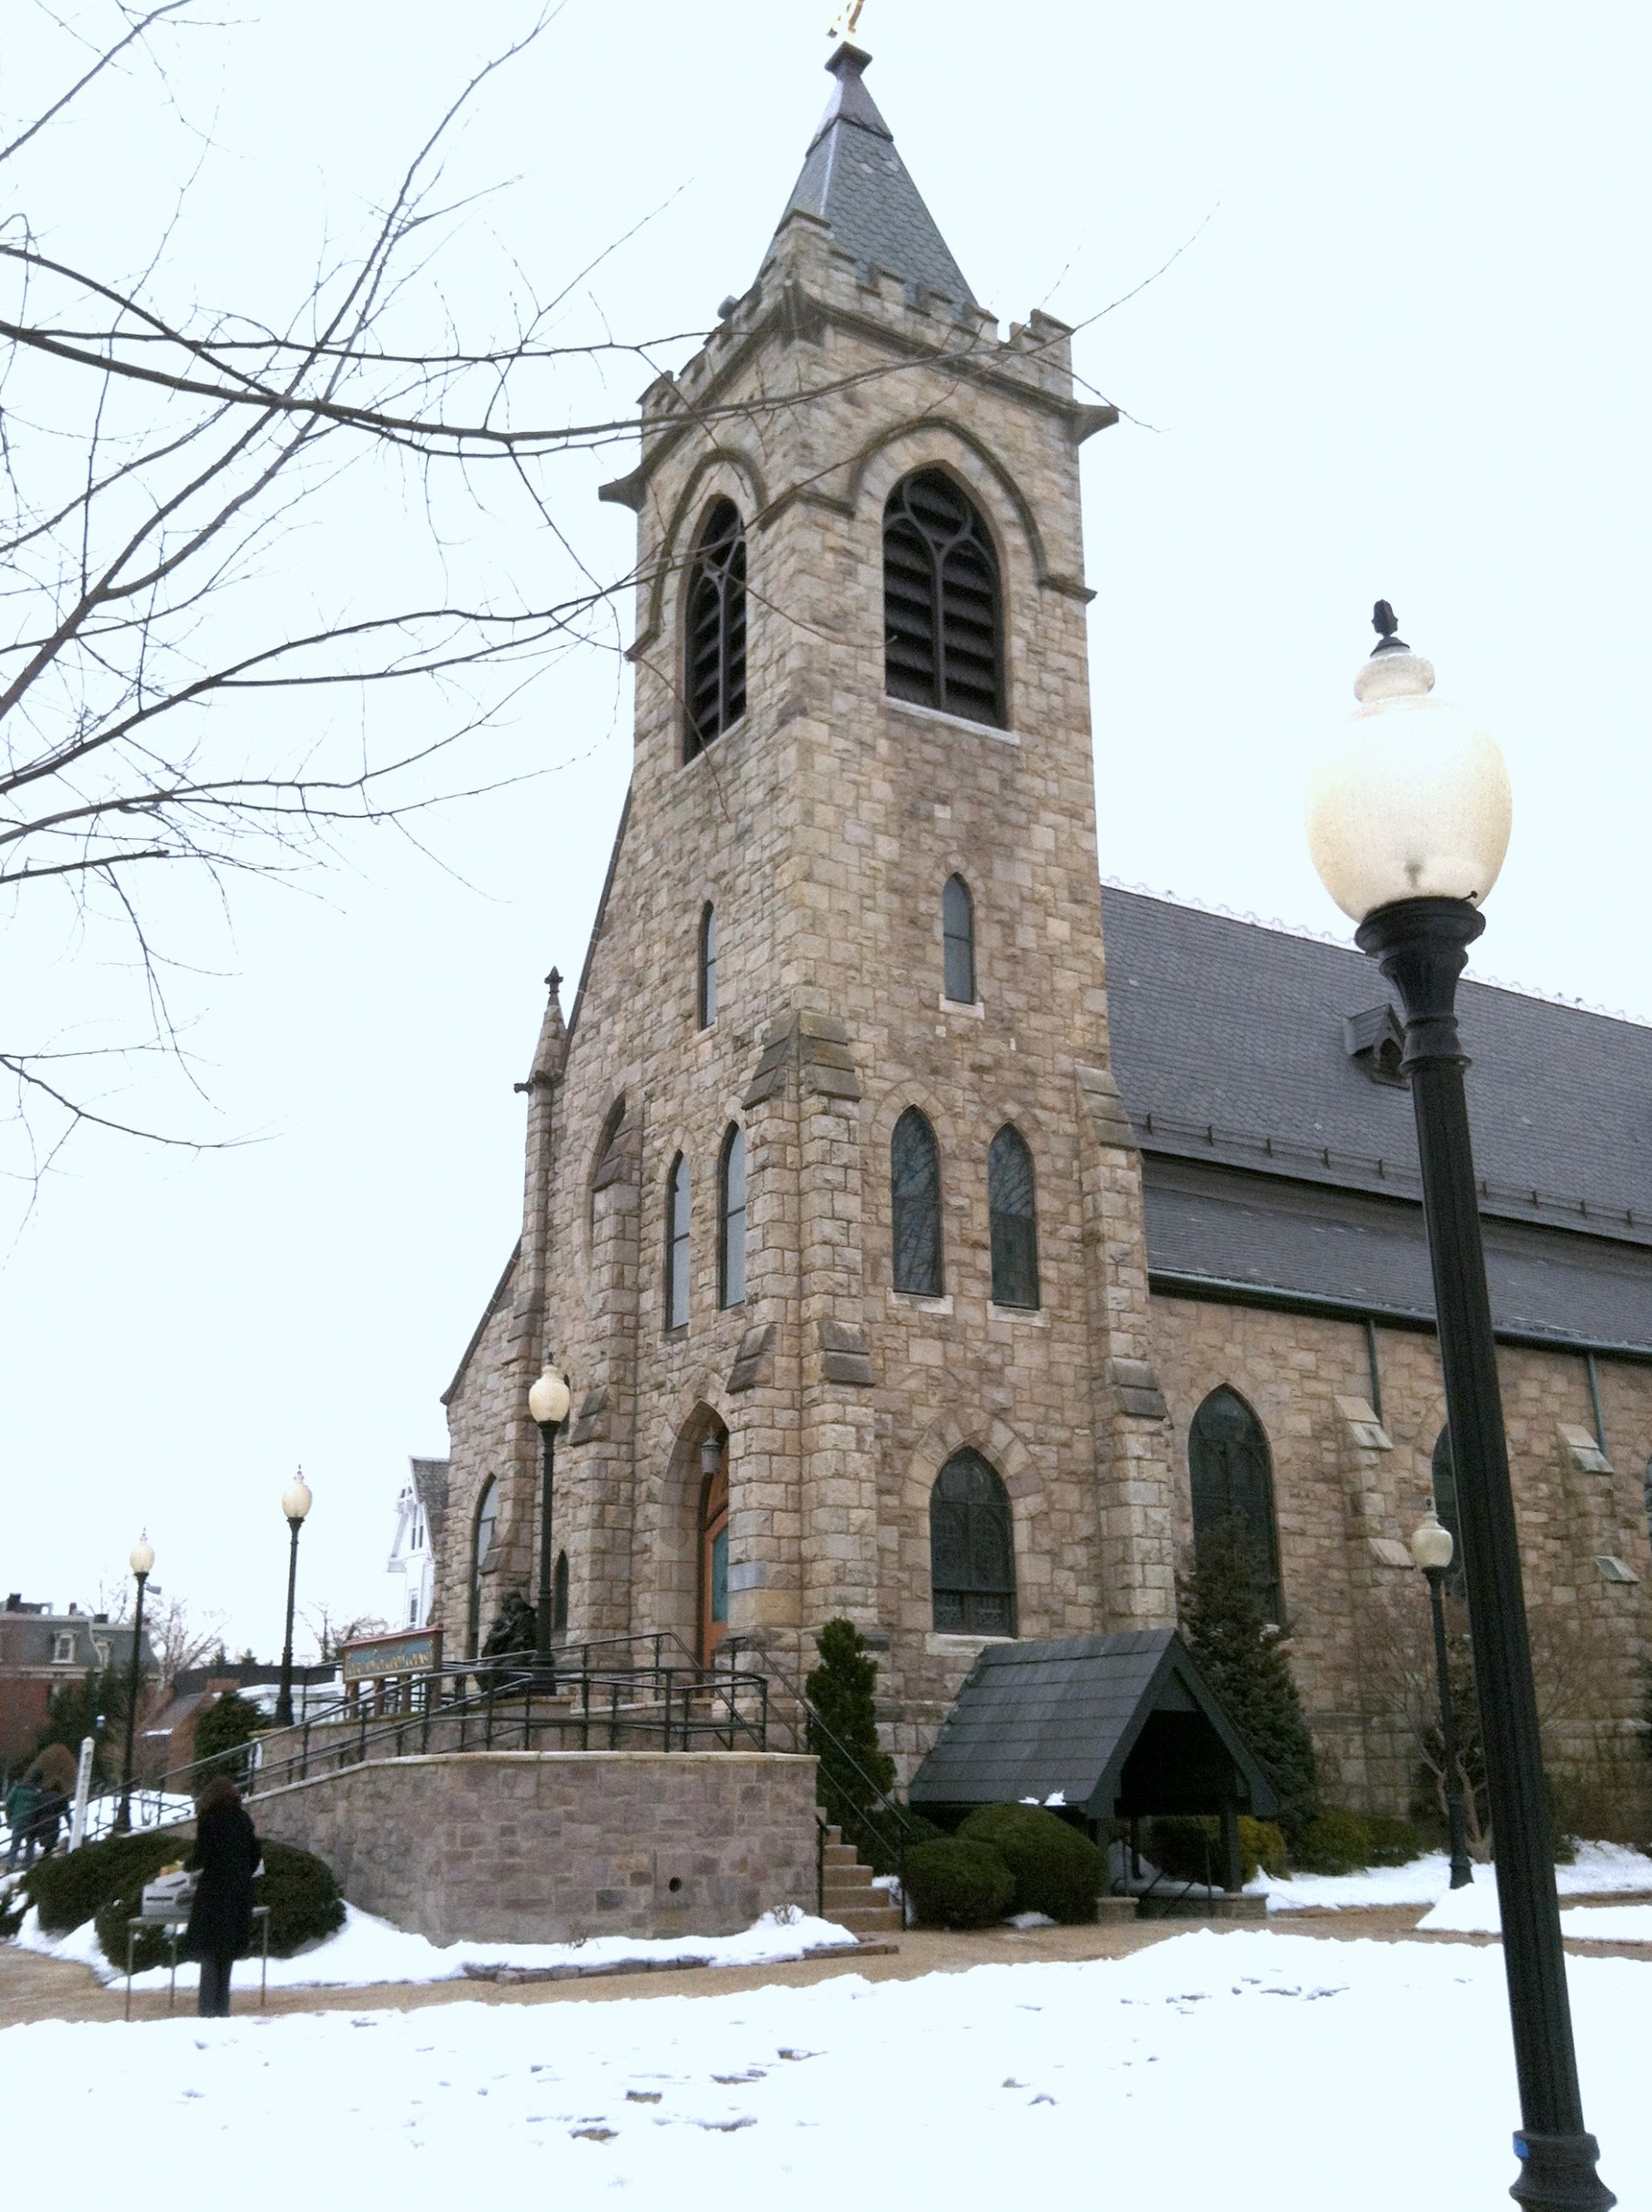
Making Moral Decisions
-As we become older we are going to have to make tough and difficult decisions. Some more serious than others. -Some of these decisions may be: *Which college to attend, should I go or skip mass, should I partake in things that I know may not be a good idea but I see my friends do it, -The Church, our parents, the Holy Spirit can help us make good moral decisions. -The gift of free will is what allows us to choose between right and wrong. -As we grow and mature we must continue to educated and form our conscience.

Slide 3
The Value of Life
-We must respect all human life. -Today there remain many major threats to human life which are: *Murder *Abortion *Euthanasia *Terrorism *Suicide *Human trafficking *Poverty and discrimination *Drug and alcohol abuse

Slide 4
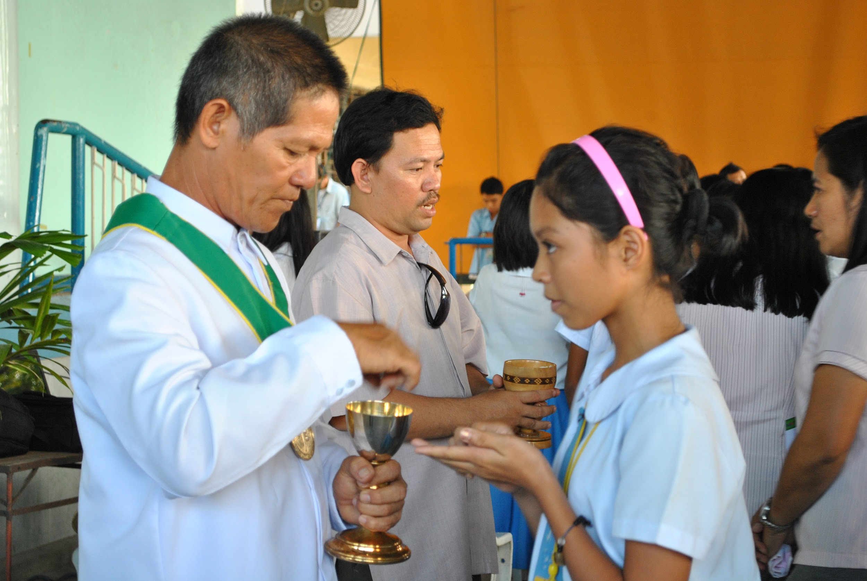
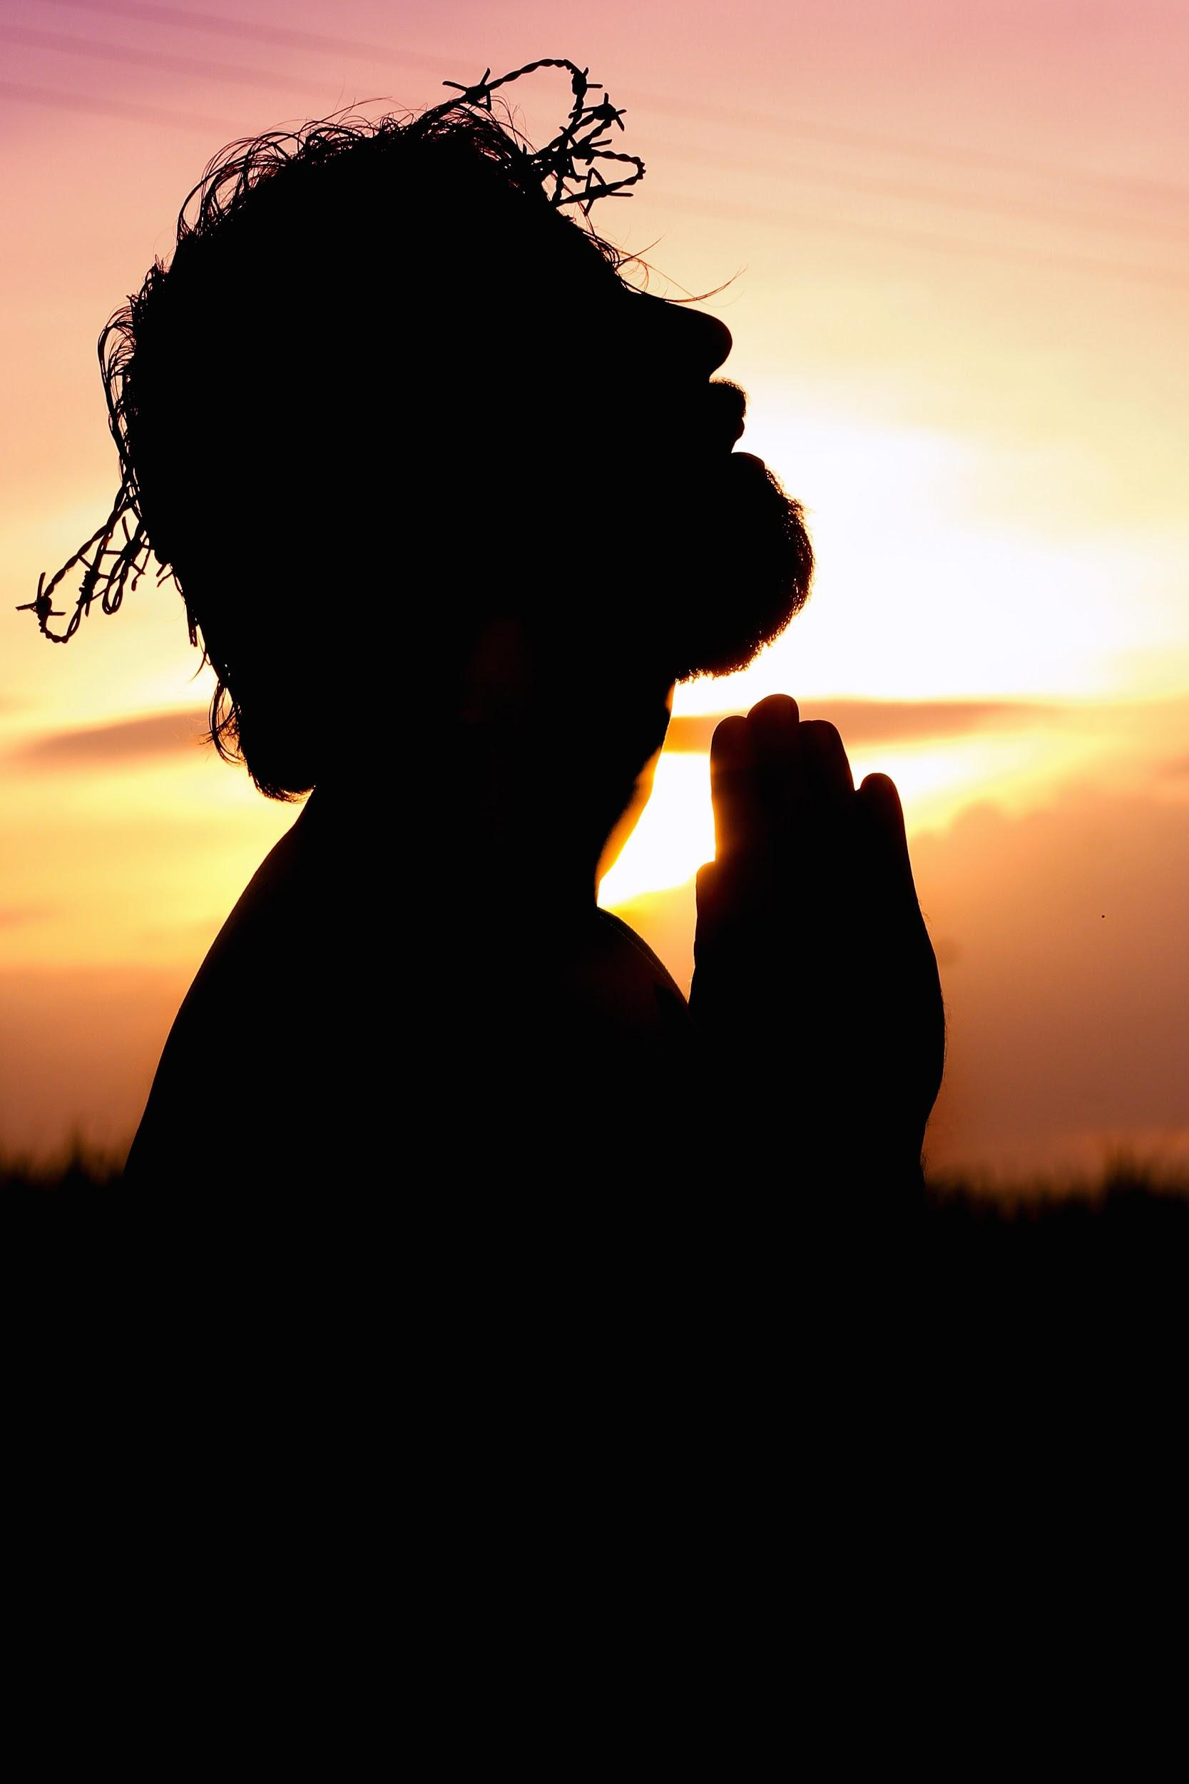
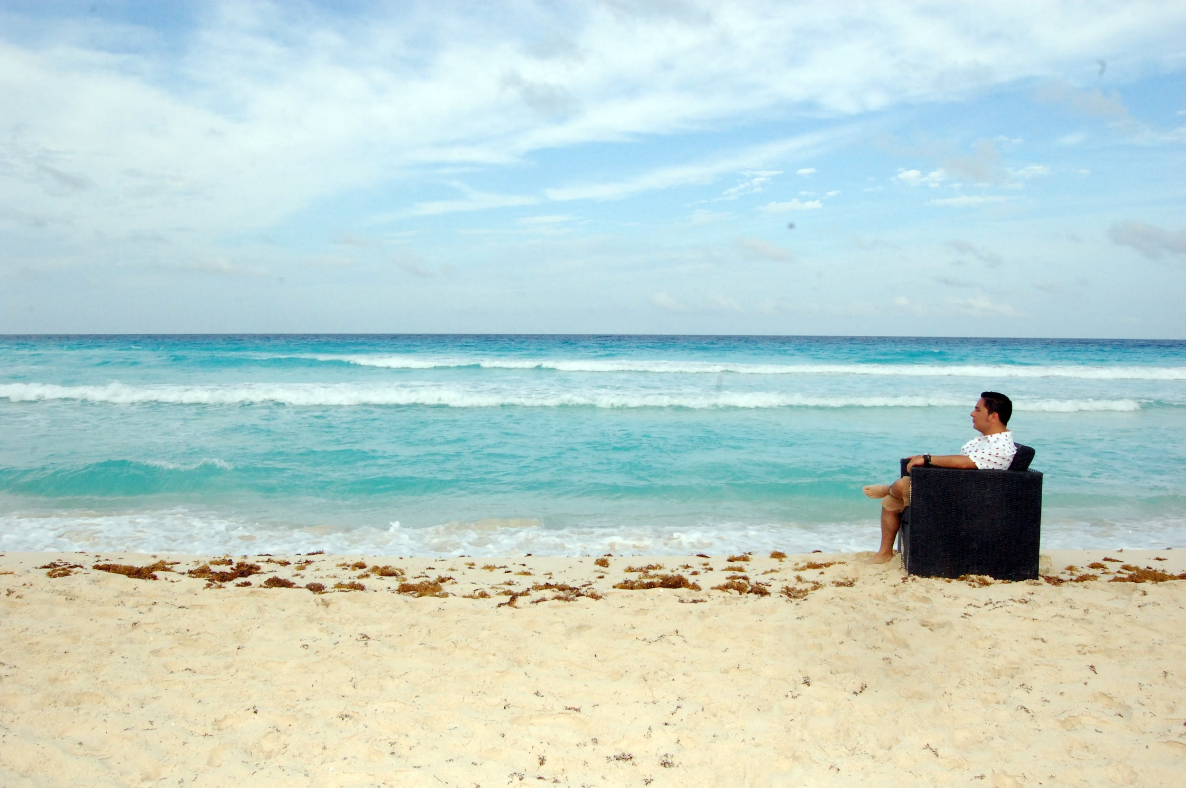
Spiritual, Physical, and Emotional Health
-Taking care of one’s spiritual, physical, and emotional health ties into the corporal and spiritual works of mercy. -Physical health eating a balanced diet, exercise, stay away from drugs, smoking, alcohol, putting the devices down, practicing good hygiene. -Spiritual health spending time reading scripture, going to mass, praying quietly, receiving the sacraments. -Emotional health being patient, taking time for just you, spending time reflecting on your day if it was good or bad, and if it was bad what can be done to make it better.

Slide 5
The Social Scene
-Looking back at making moral choices takes us to what types of friendships and relationships have we formed. -Are the groups of friends that we have made hurtful or harmful to us in anyway. -Social networking and the internet. *Do we speak to others who we do not know, do we give out private personal information to strangers, are our social media pages open to anyone and everyone, do we behave inappropriately when using social media?

